Slide 1
Personal Practical Cybersecurity for Modern Times

Slide 2
Awareness is the best Digital Defense
“It’s difficult to ignore how commonplace large-scale hacks have become, and there’s no sign that this form of criminality is going to die off. There is no defense that’s 100 percent capable of blocking any kind of attack; criminals will always find a way to exploit even the smallest weakness. Although it’s not easy, the best way to stay safe online is to be aware of the threats, and aware of what can be done to safeguard against those threats.
Online security is like paying for insurance, or going to the dentist. It doesn’t seem that important, until it is. It’s not enough to simply opt-in to the forms of protection we’re offered by various sites and services. Knowing what kind of attacks these protections defend us from — and what they don’t — is the only way to take charge of your own security.”
Brad Jones, DigitalTrends, 2017 https://www.digitaltrends.com/computing/why-2-factor-security-is-flawed/

Slide 3
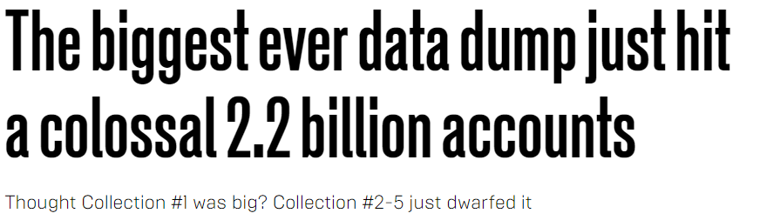
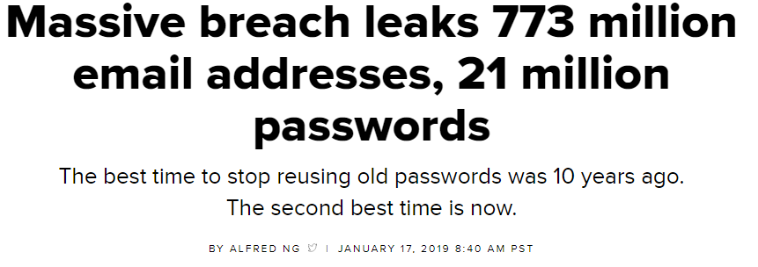
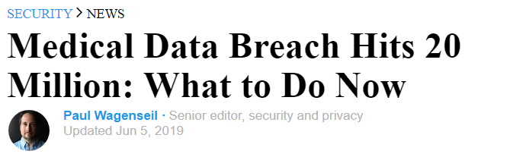
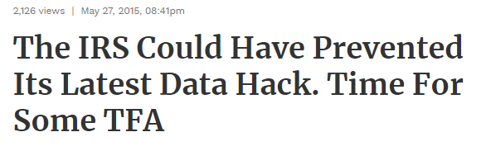
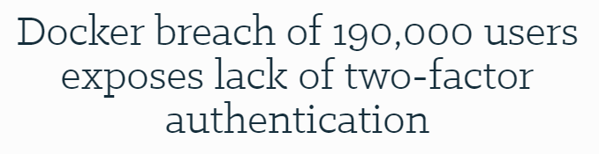
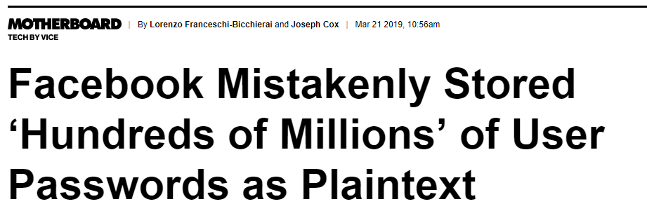
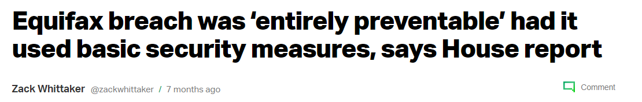
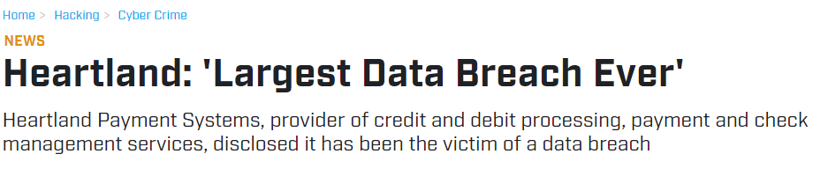
Don’t ever re-use passwords.
Yep, a new password for every login. Seriously.

Slide 4
Password length and complexity are useless once some website or service leaks your username/email and password.

Slide 5
Password Hygiene
Has your email been part of any password leaks? haveibeenpwned.com
Spoiler alert: Almost Certainly
“People take lists like these that contain our email addresses and passwords then they attempt to see where else they work. The success of this approach is predicated on the fact that people reuse the same credentials on multiple services.” –Troy Hunt, haveibeenpwned.com

Slide 6
Password Hygiene
True now and always:
Password length > Password complexity
Password complexity leads directly to bad security habits (post-it notes or easy to guess)
Password uniqueness > Password length
Passwords alone are terrible security

Slide 7
Your Email Account > Your Bank Account
Having your email hacked can be worse than having your bank account hacked.
Your email account is a single point of failure for many sites.

Slide 8
Password Managers
Great for generating and storing secure passwords, so that you don’t have to remember a unique password for each site. These options are popular, secure, and inexpensive:
LastPass
1Password
Dashlane
KeePassX

Slide 9
Password Managers
Basic idea: You have one unique super password to unlock everything else. Obviously, don’t re-use it.
Pro: All your passwords are super long, super strong, unique, and available to you anywhere
Con: forget the one unique super password despite typing it in all the time, and they cannot decrypt your passwords for you

Slide 10
Password Managers
The password manager you choose should have the following options:
Allow to easily retrieve and paste into a website
Have a mobile app to allow for mobile logins
Can import from browser-based password memory
Can warn you if you’re re-using the same password
Use TFA/MFA to access your stored passwords

Slide 11
What is Two Factor Authentication (TFA)
Passwords alone are a terrible security method
TFA or MFA (Two-factor or Multi-factor) authentication is something aside from a password that allows a website to confirm you are you.

Slide 12
What is Two Factor Authentication
Use TFA for EVERY ACCOUNT on EVERY WEBSITE YOU CAN:
Email, Google/iCloud/Microsoft
Banking/Financial/Bill Payment
Cloud storage/assets, Github, Bitbucket, other Work
Employer on Office365 or GSuite? They can enable TFA!
But also, TFA is available for many websites:
Social media, e-commerce, Gaming and Streaming services
Government, public service, utility providers
Want to know if a site supports TFA? twofactorauth.org or just got to the security settings/menu and see. Most do.

Slide 13
What is Two Factor Authentication
TFA is hardly a new concept, but the implementation is still developing and the industry is always trying to overcome consumer’s desire to be really dumb and stubborn.
Asymmetric encrypted hardware key algorithms have been around since 1970s, some weren’t declassified until late 90s
The RSA algorithm patent was made public domain in 2000
The first driverless, one-touch auth USB device in 2008
Google provided TFA to all accounts as early as 2010

Slide 14
Common TFA Types
Text message (SMS)
Software-based authenticators
Hardware-based authenticators

Slide 15
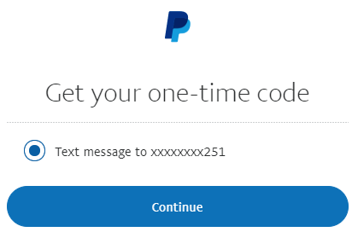

Text-Message (SMS) Based Authentication
After you log in, the website sends you an SMS to a phone number you have previously stored with them.
You type in the number within a certain amount of time, and the website knows it was you who received the text message.
Vulnerabilities in carriers, including social engineering or SIM card hacks have made this type of TFA obsolete and unsecure.

Slide 16
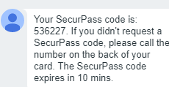
Text-Message (SMS) Based Authentication
“I’m going to send you a secure code to make sure you’re not a scammer”
A common tactic on public listing sites like Craigslist, Ebay, etc. THEY are not sending you a six digit code. They’re trying act as you to your your cell carrier.
If you are sent a code via text message, NEVER EVER TELL IT TO ANYONE ELSE.
Didn’t ask for it? Could be a sign someone is trying to hack you.
They are misusing the same system that allows you to keep your phone number when you transfer cell providers, which carriers must provide you required by law!
This is an actual scam!

Slide 17
Text-Message (SMS) Based Authentication
If a site offers another option besides SMS TFA, use it.
Unfortunately, many banks ONLY provide this option.
SMS-based authentication is much better than no TFA
Yahoo and Reddit have each been breached after they were targeted by SMS-based TFA. In each case, the hackers targeted specific admins and their phones, intercepted the text messages and/or changed their passwords.

Slide 18
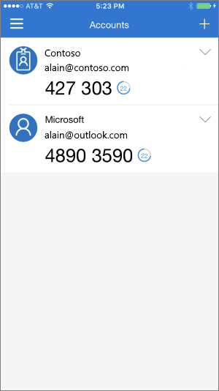
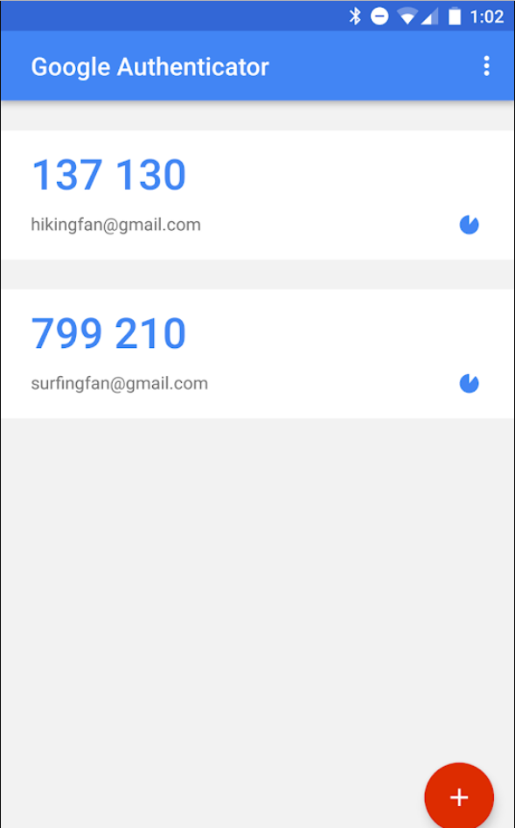
Software-Based Authentication
Time-based, One-Time Password Algorithm
Given an initial secret, your phone can generate a code that changes at intervals.
The website uses the shared key to generate the same code.

Slide 19
Software-Based Authentication
Mobile apps:
Google Authenticator
Microsoft Azure Authenticator
LastPass Authenticator
Authy: multiplatform free service for software TFA
Enterprise mobile apps:
Symantec VIP, RSA, Duo

Slide 20
Software-Based Authentication
An Authenticator “app” for your phone generates a number which you type in to the website, or approve via a push notification.
This is far more secure than text-message (SMS) based authentication.
Your phone holds the key. Which means if you lose your phone, you’ll need a backup method.

Slide 21
Software-Based Authentication
When you set up a TFA App with a new website or account, you’ll be provided a QR code or long string you only see once, SAVE THESE SECURELY and SEPARATELY for future convenience.
You can use the same QR Code or string to transfer phones or create backup devices with the same TFA code generation.
You’ll also be given a set of “backup” one-time use codes. STORE THESE SECURELY AND SEPERATELY. You may need to use one in a pinch to gain access if you’ve lost your phone.

Slide 22
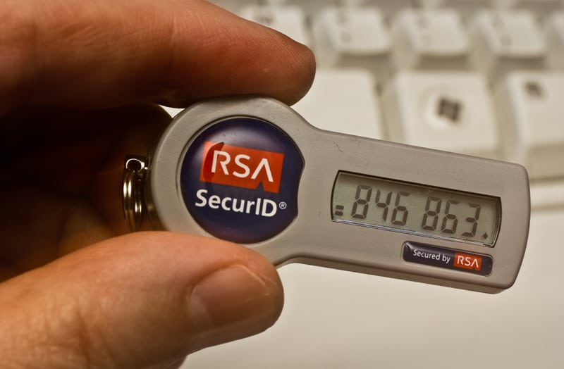
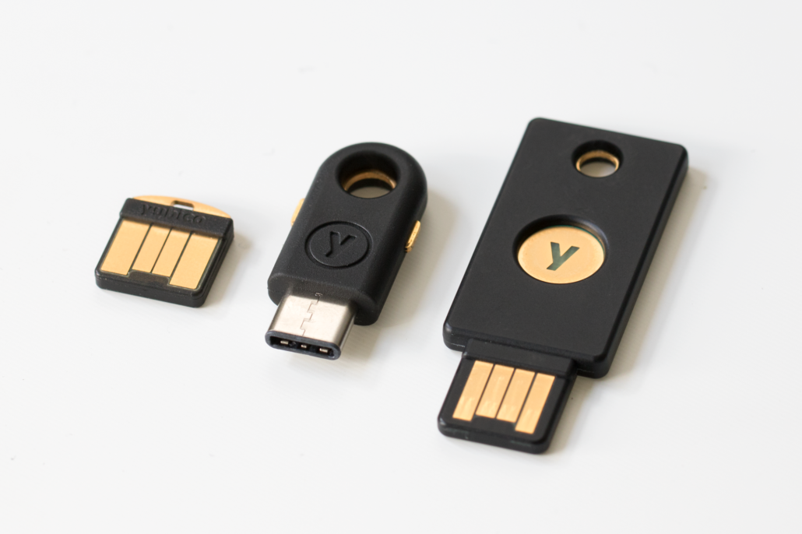
Hardware-Based Authentication
Very similar to Software-based authentication, but not on a phone or app, rather, generated by a simple processor that generates number codes based on a pre-known secret.
Or, a hardware key that integrates with software to provide a TFA presence only when plugged into a USB port on the accessing device, when a button is pressed.

Slide 23
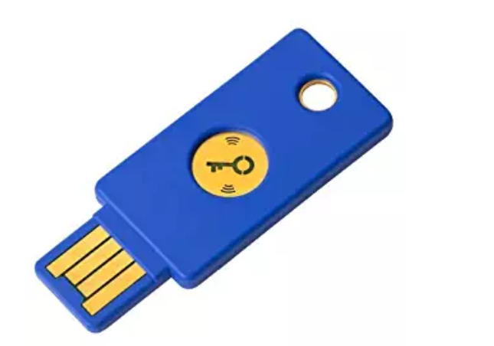
Hardware-Based Authentication
Some hardware based keys are easier because there’s no number, but ties physical security (your chain of keys) to digital security, not something you may be used to and will require you to change habits.
You can (and should!) create duplicate keys with the same secrets, store one in a safe at home, for example.
Pictured: Yubikey ($25 on Amazon)

Slide 24
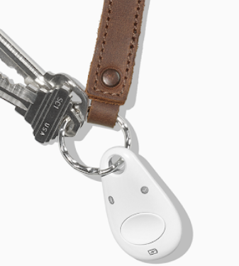
Hardware-Based Authentication
You need TFA for your phone, for email access, etc.
Some hardware-based keys support Bluetooth or NFC, or, carry a USB-C to USB adapter
Google’s Titan (right) is the only option right now with Bluetooth and NFC on the latest FIDO standard
Again, this is still an immature industry

Slide 25
Can’t Trust Google Implicitly, But
Google offers a free platform utilizing hardware TFA for “anyone at risk of targeted attacks – like journalists, activists, business leaders, and political campaign teams.“ https://landing.google.com/advancedprotection/
“Google has not had any of its 85,000+ employees successfully phished on their work-related accounts since early 2017, when it began requiring all employees to use physical Security Keys in place of passwords and one-time codes.” https://krebsonsecurity.com/2018/07/google-security-keys-neutralized-employee-phishing/

Slide 26
Google TFA FAQ
Do I need to keep a Security Key with me at all times?
We recommend you always keep a Security Key close in case you log out of your account or need to sign in on a new device. In all likelihood, this will happen infrequently. Remember to take one with you when traveling.
What happens if I lose both of my Security Keys?
If you still have access to a logged-in session, you can visit account.google.com and register replacement keys in place of the lost keys. If you have lost both keys and do not have access to a logged-in session, you will need to submit a request to recover your account. It will take a few days for Google to verify it’s you and grant you access to your account.

Slide 27
Hardware-Based Authentication
This industry is still somewhat immature and is advancing, but this is not an excuse to not act. Take steps now!

Slide 28
More Reading
How Russian Cyberpower Invaded the U.S. https://www.nytimes.com/2016/12/13/us/politics/russia-hack-election-dnc.html
How to protect yourself from 'spear phishing' hacking technique https://phys.org/news/2018-07-spear-phishing-hacking-technique.html
Reddit Breach Highlights Limits of SMS-Based Authentication https://krebsonsecurity.com/2018/08/reddit-breach-highlights-limits-of-sms-based-authentication/
This is why you shouldn’t use texts for two-factor authentication https://www.theverge.com/2017/9/18/16328172/sms-two-factor-authentication-hack-password-bitcoin
Two-Factor Authentication: Who Has It and How to Set It Up https://www.pcmag.com/feature/358289/two-factor-authentication-who-has-it-and-how-to-set-it-up
Hackers beat 2-factor protection with automated phishing attacks https://mashable.com/article/hackers-beat-two-factor-authentication-2fa-phishing
Creating the Unphishable Security Key: How the FIDO U2F security key and YubiKey stop phishing and man-in-the-middle attacks www.yubico.com/2017/10/creating-unphishable-security-key/
What is two-factor authentication, and which 2FA solutions are best?https://www.pcworld.com/article/3225913/what-is-two-factor-authentication-and-which-2fa-apps-are-best.html
Let's find the right YubiKey for you. https://www.yubico.com/quiz/
The Limits of SMS for 2-Factor Authentication https://krebsonsecurity.com/2016/09/the-limits-of-sms-for-2-factor-authentication/
Major SMS security lapse is a reminder to use authenticator apps instead https://www.theverge.com/2018/11/16/18098286/vovox-security-breach-two-factor-authentication-2fa-codes-exposed
Metro Bank targeted with 2FA-bypassing SS7 attacks https://www.itpro.co.uk/security/32898/metro-bank-targeted-with-2fa-bypassing-ss7-attacks

